Slide 1

Trust Scan QR: Intelligent Java-Based System for Detecting Malicious QR Codes with Risk Scoring and URL Analysis
PRESENTED BY:
M PRITHIYANKA SHREE 192521144
DHANUSHYA RB 192565033
JAYARANI V 192524115
Guided by:
Dr.A.Mohan
Dr.E.Meghanathan

Slide 2



INTRODUCTION
QR codes are widely used in daily life for payments, websites, and information sharing
They provide quick access by simply scanning through mobile devices
However, QR codes can hide malicious links without user awareness
Attackers can use QR codes to redirect users to phishing or fake websites
Users usually scan QR codes without verifying their safety
This creates serious security risks like data theft and financial fraud
This project focuses on detecting and analyzing QR code threats using Java

Slide 3
PROBLEM STATEMENT
QR codes are widely used for payments, advertisements, websites, and information sharing.
Users often scan QR codes without knowing the destination or security risks involved.
Cybercriminals can use malicious QR codes to redirect users to phishing, fake payment, or malware websites.
Traditional QR scanners only decode the content and do not analyze potential threats.
There is a need for a system that can assess QR code safety before users access the embedded links.
This project aims to provide risk-based QR code analysis and threat detection using Java.

Slide 4

OBJECTIVES
To develop a Java-based system for analyzing QR codes and detecting security threats.
To decode QR codes and extract embedded URLs from uploaded images.
To identify suspicious URLs, phishing attempts, and potentially malicious links.
To evaluate URL safety using multiple security parameters and generate a risk score.
To provide clear, explainable results that help users make safer decisions before opening QR code links.

Slide 5
LITERATURE REVIEW
AUTHOR (YEAR) | PAPER TITLE | KEY FINDINGS & RELEVANCE
Singh & Kumar (2025) | QR Code Security: Emerging Threats and Countermeasures | Identified phishing attacks through malicious QR codes. Highlights the need for QR code security analysis before users open links.
Chen et al. (2024) | Detection of Malicious URLs Using Risk-Based Analysis | Demonstrated that URL features such as HTTPS status, suspicious keywords, and URL patterns are effective indicators of malicious intent.
NIST Cybersecurity Report (2024) | Guidelines for Phishing and Social Engineering Prevention | Emphasized phishing URLs as a major cybersecurity threat and recommended proactive URL verification mechanisms.
Ahmed & Rashid (2024) | Explainable Security Analysis for Web Threat Detection | Proposed explainable threat analysis instead of simple Safe/Unsafe classification, improving transparency and user trust.

Slide 6
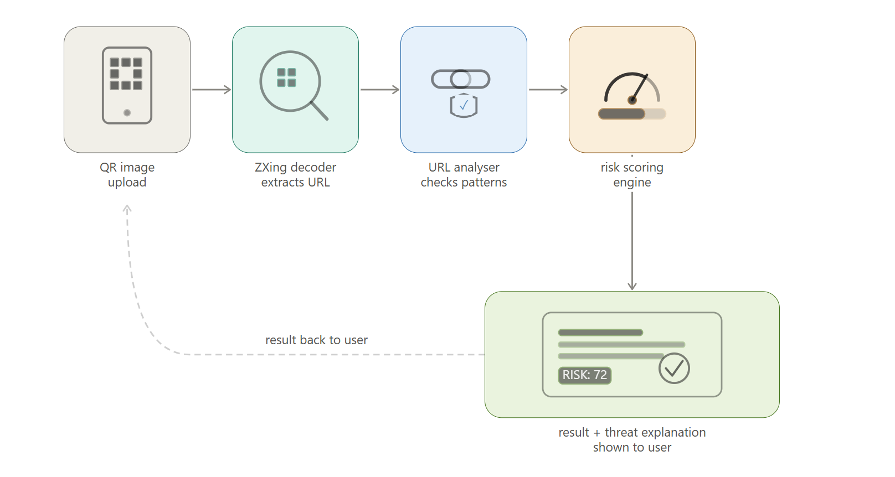
SYSTEM ARCHITECTURE

Slide 7

SCHEDULING ALGORITHM
The system follows a sequential workflow model for processing QR codes.
QR code image is received and decoded to extract the embedded URL.
The extracted URL is validated and analyzed for security threats.
Multiple security checks are performed to identify suspicious patterns.
A risk score is generated based on the detected threats.
The final result is displayed with the risk score and threat explanation.

Slide 8
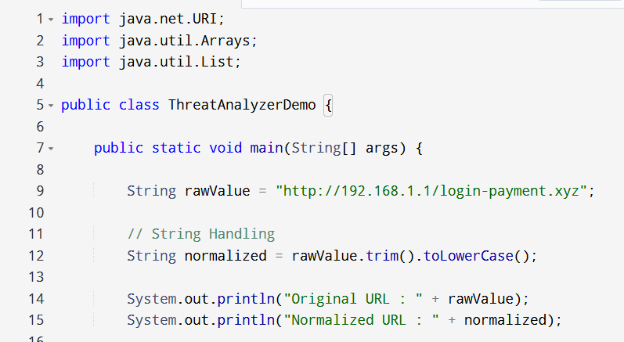
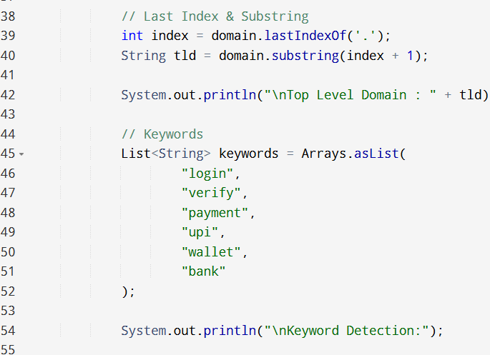
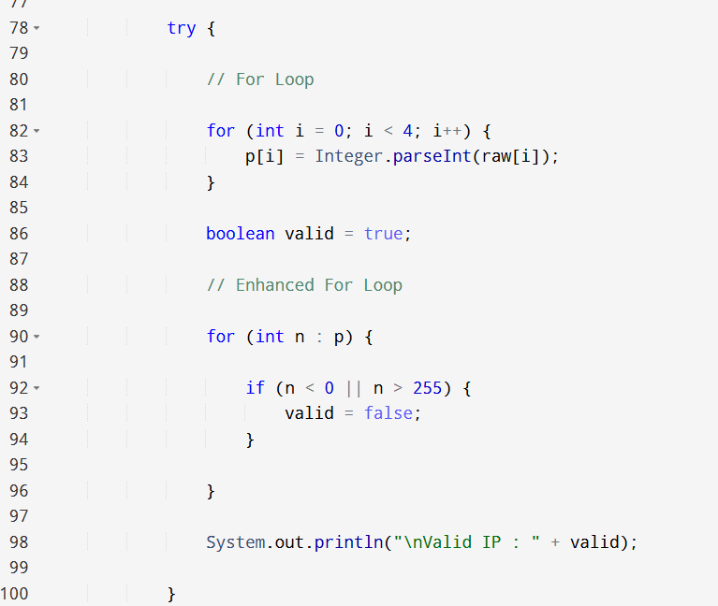
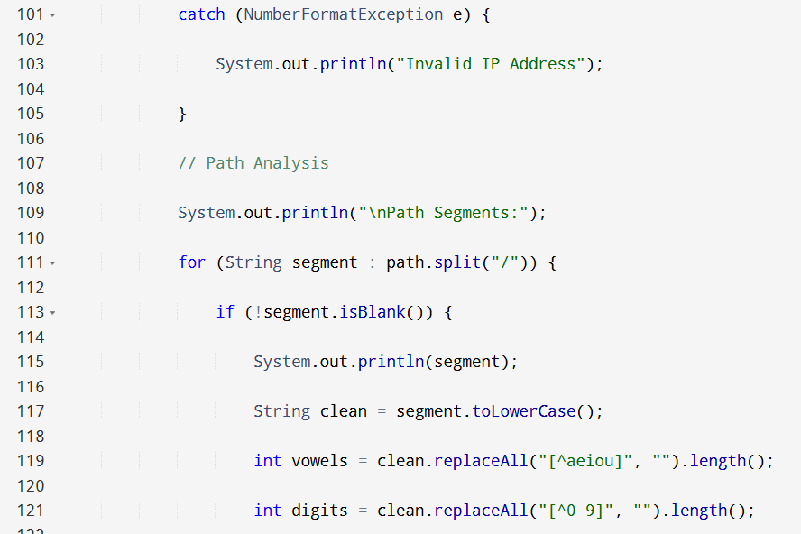
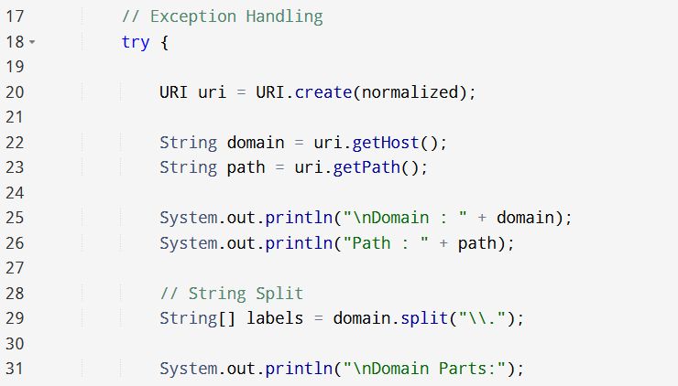
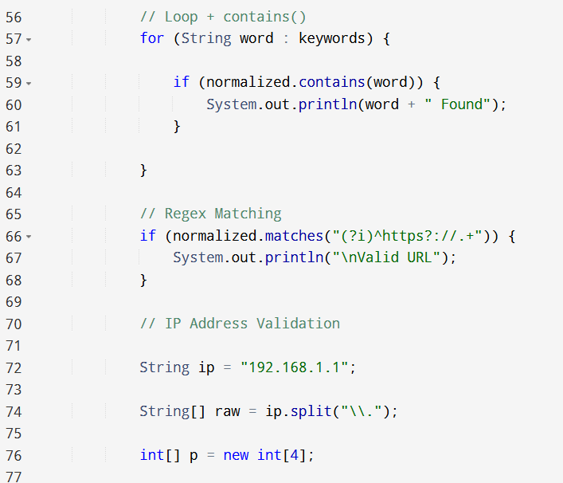
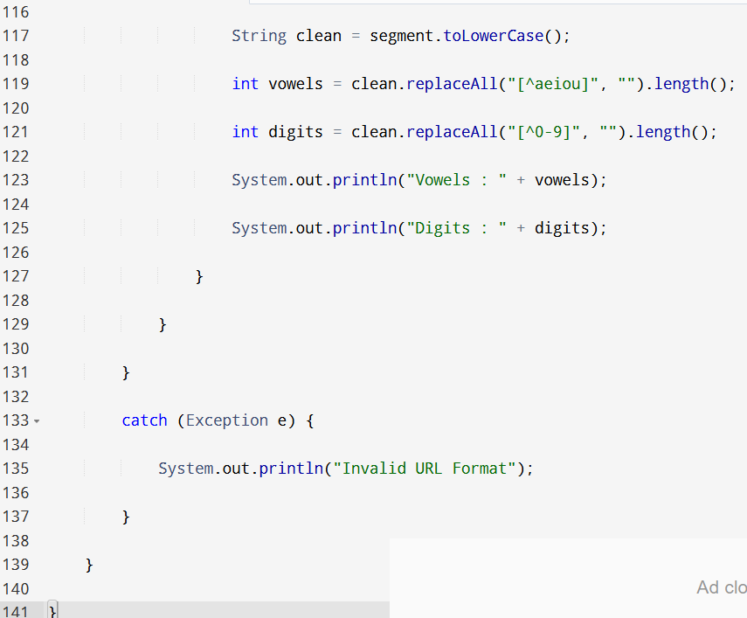

Slide 9
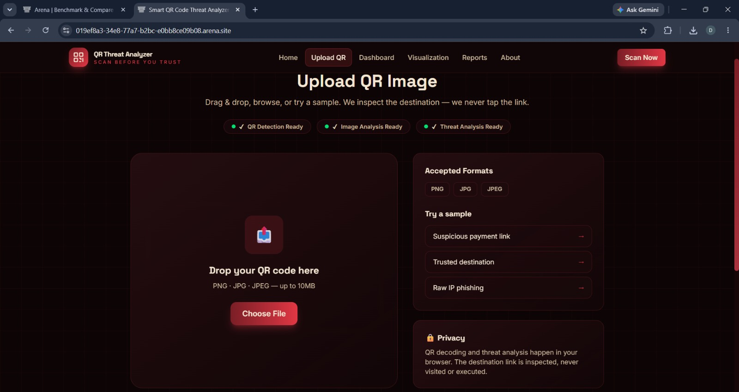
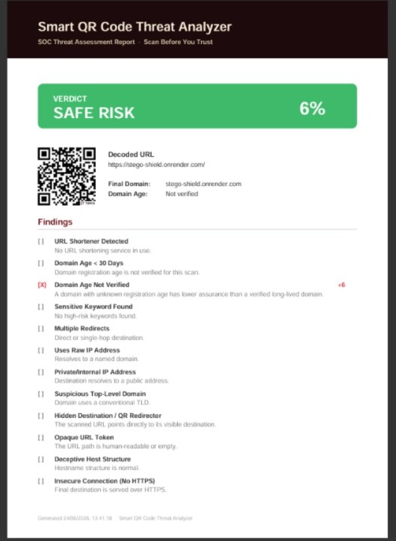
OUTPUT

Slide 10
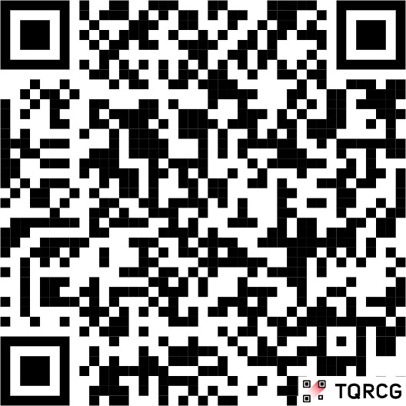
CONCLUSION
The Smart QR Code Threat Analyzer successfully detects and analyzes QR code risks
It helps users identify malicious or suspicious QR codes before opening links
The system decodes QR codes and extracts embedded URLs efficiently
It reduces the chances of phishing attacks and online fraud through QR codes
The Java-based implementation ensures simplicity and reliability
Overall, the system improves user safety in QR code usage and digital transactions

Slide 11
REFERENCES
Java SE Documentation – Oracle
ZXing (“Zebra Crossing”) QR Code Library Documentation
IEEE Papers on QR Code Security and Phishing Detection
Research articles on URL-based threat analysis and cyber security systems
Cybersecurity guidelines related to phishing and malicious link detection
Online Java tutorials and documentation for networking and file handling
Standard textbooks on Object-Oriented Programming using Java
Articles on real-world QR code misuse in digital payment systems

Slide 12
THANK YOU

Slide 13
